Slide 1
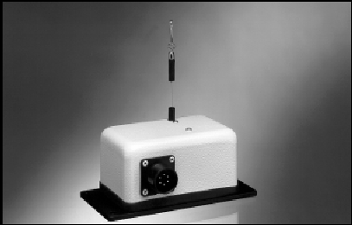
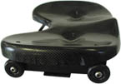
Trial 2 – Unsuccessful – Slide Timing
Using a Celesco PT510 Cable Extension Position Transducer or “String Pot” as it is more commonly referred to, we will measure the position of the rowers slide.
ENCL-2

